Slide 1
Startups Initiated by TLSU

Slide 2
HNK Beverages by Naimish Jaiswal

Slide 3
Mohit Agrawal

Slide 4
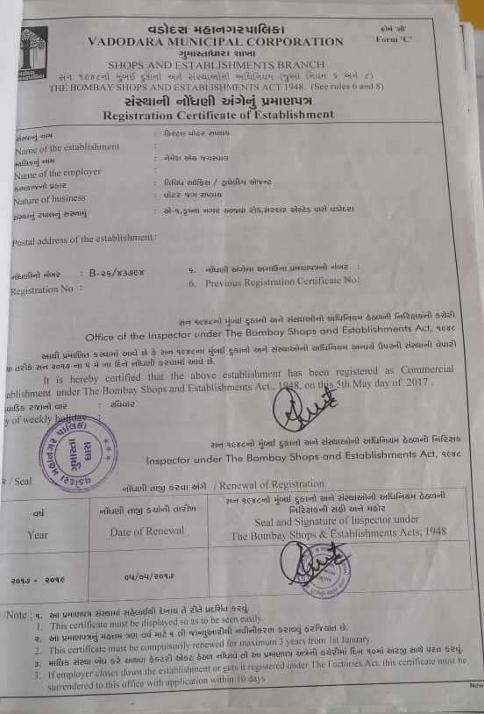
Crystal Water Supply

Slide 5
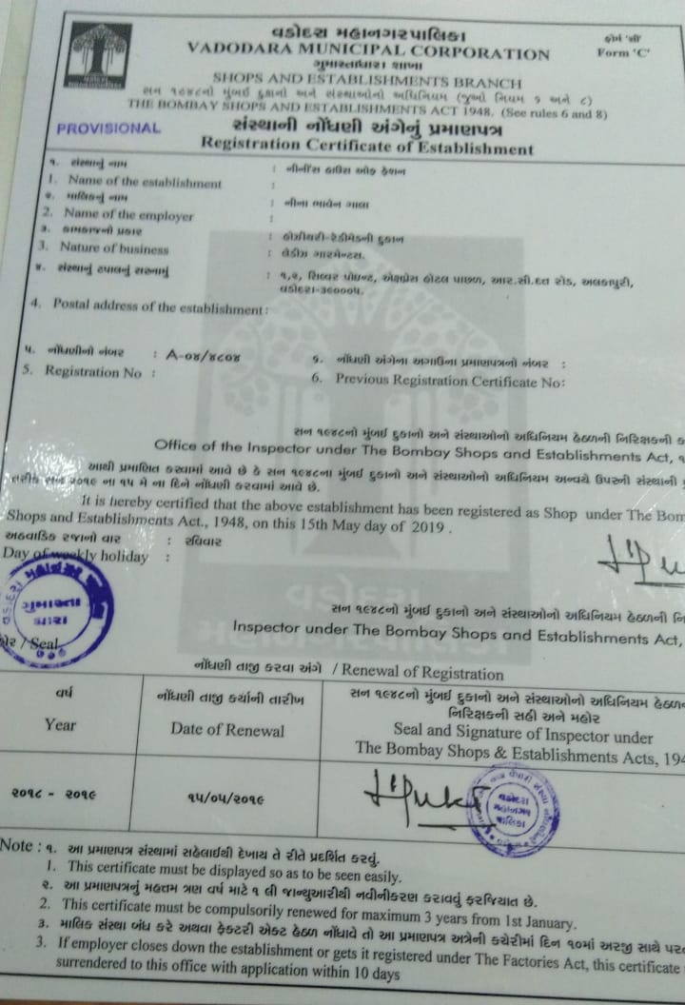
Ninni’s Fashion

Slide 6
Ronak Palrecha – Wealthstone Finance

